Slide 1
Creating Friendly Layers, 2022 Edition
Paul Barker, SanCloud Ltd
Yocto Project Summit, 2022.11

Slide 2


About Me
Involved in Yocto Project since 2013
Work across the whole embedded stack
Principal Engineer @ SanCloud Ltd
📧 paul@pbarker.dev
@pbarker@social.afront.org

Slide 3


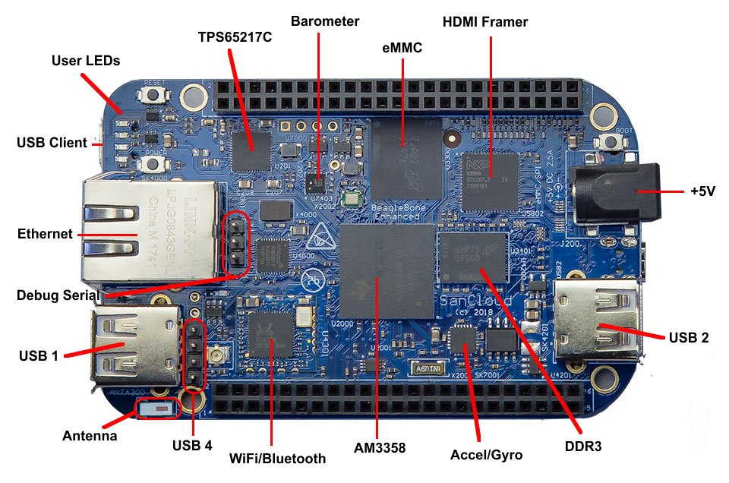
About SanCloud
Custom & Off-The-Shelf Embedded/IoT Hardware
Cloud hosted or on-site IoT Platform
Open Source focussed
Global customer base
UK head office
BeagleBone Enhanced (BBE)

Slide 4
About This Talk
For layer creator & maintainers
What & Why?
Best Practices
  Layers to learn from
  Methods
  Examples
Parsing details of bblayers.conf and layer.conf files
Updated Edition
For Kirkstone & Langdale releases

Slide 5

There Shall Be No Victims
I won’t be showing examples of bad practice today
Sorry to disappoint!

Slide 6
What is a Friendly Layer?
Simply adding the layer doesn’t change functionality
Doesn’t assume MACHINE, DISTRO, etc
Careful use of bbappends
Avoid clashing with recipe names in existing layers
Place python helpers in a lib directory
  Avoid littering the global namespace

Slide 7
Why Should You Care?
Yocto Project Compatible badge requires this
Makes it easier to integrate with other layers
  Less likely to cause conflicts
Easier to test and debug builds
  Can quickly turn features on and off
Can reduce the number of layers you need to create
  Check MACHINE instead of having one layer per machine
  Check features instead of having one layer per feature
Actually simplifies development of your layer

Slide 8
But Can’t You Just Dynamically Set BBLAYERS?
Not in a multiconfig
Not based on variables in local.conf or some layer
  So you may not even know MACHINE, DISTRO, etc
Not even very easily in bblayers.conf
  Parsing limitations discussed later
Dynamically creating bblayers.conf for each build means another script to maintain

Slide 9



Build a Friendly Community
Provide documentation
Provide clear contribution guidelines
  How to send patches
  Where to report issues
  If needed, adopt a Code of Conduct
Use inclusive language

Slide 10
Layers To Learn From
meta-virtualization
meta-clang
meta-security
meta-raspberrypi

Slide 11
Documenting Your Layer
You need a README
Consider adding a ‘docs’ folder at the top level
  Sphinx (http://www.sphinx-doc.org) is a good choice
  Can publish to Read the Docs (https://readthedocs.org)
Also clearly identify
  Licensing
  How to contribute
  Support forums, mailing lists or email addresses

Slide 12
Keep layer.conf Simple
Settings in layer.conf apply to all recipes
  Not just those in your layer
Often difficult to override things set in layer.conf
Parsed very early
  Details covered in appendix slides
  Parsed in BBLAYERS order not BBFILE_PRIORITY order

Slide 13
Adding New Content in Layers
New content is typically safe to add
  New recipes
  New classes
  New machines
  New distros
Watch out for name clashes
  Search the layer index first: https://layers.openembeded.org/

Slide 14
Modifying Existing Recipes
This is where you can cause problems
Don’t indiscriminately modify variables and tasks
Use overrides and conditionals
Check MACHINE, DISTRO, feature variables, etc

Slide 15
Avoid Network Access Outside do_fetch
Network access disabled by default outside do_fetch in recent releases
Do not override this!
  Especially not for do_configure/do_compile/do_install
  Likely to break license compliance tooling, source archival and many other tools!

Slide 16
Use :remove With Caution
:remove takes precedence over :append
:remove cannot be undone easily!
Avoid it if at all possible

Slide 17
Using Overrides
Extend OVERRIDES based on a variable
Use override syntax in variable assignments
Document your new variable
For example, if you support option `a` and option `b`:
OVERRIDES =. "option-${OPTION}"
SRC_URI:append:option-a = "file://a.patch"
SRC_URI:append:option-b = "file://b.patch file://b.conf"

Slide 18
Example: Toolchain Override in meta-clang
In clang.bbclass:
OVERRIDES =. "${@['', 'toolchain-${TOOLCHAIN}:']['${TOOLCHAIN}' != '']}"
CC:toolchain-clang = "..."
CXX:toolchain-clang = "..."
CPP:toolchain-clang = "..."
CCLD:toolchain-clang = "..."
CLANG_TIDY_EXE:toolchain-clang = "..."
RANLIB:toolchain-clang = "..."
AR:toolchain-clang = "..."
NM:toolchain-clang = "..."

Slide 19
Using Features
Much tidier than messing with overrides
Three classes of feature variables:
  DISTRO_FEATURES
  MACHINE_FEATURES
  IMAGE_FEATURES
Also have COMBINED_FEATURES
  Intersection of DISTRO_FEATURES & MACHINE_FEATURES

Slide 20
Conditional Syntax
Python expressions
  Can call a function `fn` with the syntax `${@fn()}`
Commonly used condition function:
  bb.utils.contains – is `checkvalues` a subset of `variable`?
  def contains(variable, checkvalues, truevalue, falsevalue, d):
  if checkvalues.issubset(variable):
  return truevalue
  else:
  return falsevalue
*Actual code is slightly more complex

Slide 21
Conditional Inclusion
You can use Python expressions in include and require statements
Example:
require ${@bb.utils.contains('DISTRO_FEATURES', ...)}
You can have a simple .inc file without conditionals if you have many changes to make based on one condition

Slide 22
Include vs Require Statements
`require` errors on missing files
  You almost always want this
`include` silently ignores missing files
  Useful for optional configs
  Useful when including something from another optional layer

Slide 23
Example: Distro Features in meta-virtualization
README
The bbappend files for some recipes (e.g. linux-yocto) in this layer need to
have 'virtualization' in DISTRO_FEATURES to have effect. To enable them, add
in configuration file the following line.
DISTRO_FEATURES:append = " virtualization"
linux-%.bbappend
include ${@bb.utils.contains('DISTRO_FEATURES', 'virtualization', '...', '', d)}
No DISTO_FEATURES conditionals needed in the .inc file

Slide 24
Example: Conditional Inheritance in meta-integrity
linux_ima.inc
inherit ${@bb.utils.contains('DISTRO_FEATURES', 'modsign',
'kernel-modsign', '', d)}
No DISTRO_FEATURES conditionals needed in kernel-modsign.bbclass

Slide 25
Adding Build-time Checks
Add a handler for bb.event.SanityCheck
  Ensures your check only runs once
Raise a flag if things look wrong
  bb.warn()
  bb.error()
  bb.fatal() if you really can’t continue
Use this if you really must limit supported values of MACHINE, DISTRO, etc

Slide 26
Example: Checks in meta-virtualization
sanity-meta-virt.bbclass
addhandler virt_bbappend_distrocheck
virt_bbappend_distrocheck[eventmask] = "bb.event.SanityCheck"
python virt_bbappend_distrocheck() {
skip_check = e.data.getVar('SKIP_META_VIRT_SANITY_CHECK') == "1"
if 'virtualization' not in e.data.getVar('DISTRO_FEATURES').split()
and not skip_check:
bb.warn("...")
}

Slide 27
Using Anonymous Python Functions
Useful when more complex conditionals are needed
  Full support for python if statements, for statements, etc
Executed at parse time
Can use d.getVar() to check variables
Can use d.setVar() to modify variables
Example:
python() {
if d.getVar('SOMEVAR').startswith('prefix'):
d.setVar('SOMEOTHERVAR', '1')
}

Slide 28
Using Classes to Modify Recipes
Define a new class in your layer
Do not set INHERIT in layer.conf or elsewhere
Document that your functionality is enabled by adding the new class to INHERIT in local.conf or a distro conf
Useful if you have similar modifications to make to many recipes

Slide 29
Modifying BBCLASSEXTEND
Appending to BBCLASSEXTEND in a bbappend is relatively safe
No need for conditionals here
May be used to add `-native` variant of an existing recipe
  Can then be used in the build of another recipe

Slide 30
yocto-check-layer Script
Layer compatibility test script
Checks recipe signatures with and without the layer present
Also checks for other common requirements:
  Does the layer have a README?
  Does everything parse correctly?
  Is LAYERSERIES_COMPAT set?
  Can we get signatures for `bitbake world`?
  Actual build is not perfomed

Slide 31
In Summary: Think About Downstream Developers
How can they extend configuration?
How can they disable things?
  Don’t force them to use :remove
Don’t assume distro, machine or target image
  If support really is limited, add a sanity check

Slide 32
Appendix: bblayers.conf Parsing Details
Parsed first
  Before any layer.conf
  Before local.conf or other user config files
  Before base.bbclass
BBLAYERS is iterated as soon as bblayers.conf is fully parsed
  Can’t depend on variables from any of the above files
No access to python lib directories from any layer
  Can’t `import oe` or any submodules
  Can’t use oe.utils.conditional(), use bb.utils.contains() instead

Slide 33
Appendix: layer.conf Parsing Details
Parsed in sequence of BBLAYERS immediately after bblayers.conf
Still before local.conf, base.bbclass, etc
Still no access to python lib directories from any layer
  Including the current layer!

Slide 34






